Slide 1




Section 10.3

Slide 2

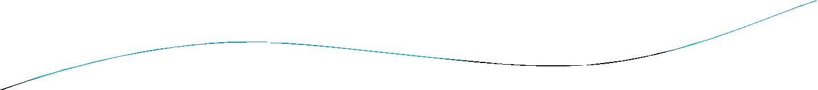
Section Summary
Adjacency Lists
Adjacency Matrices
Incidence Matrices

Slide 3

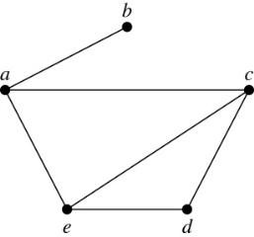
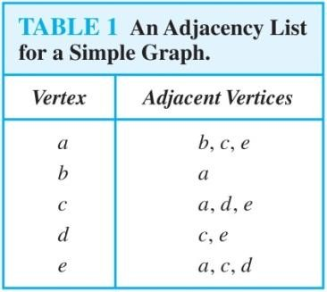
Representing Graphs: Adjacency Lists
Definition: An adjacency list can be used to represent a graph with no multiple edges by specifying the vertices that are adjacent to each vertex of the graph.
Example:

Slide 4

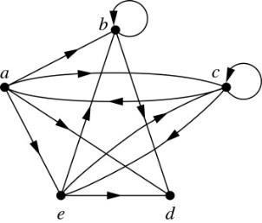
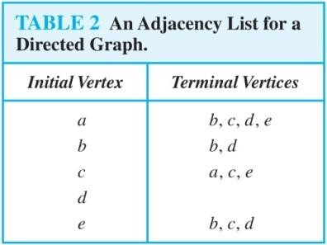
Representing Graphs: Adjacency Lists
Example:

Slide 5
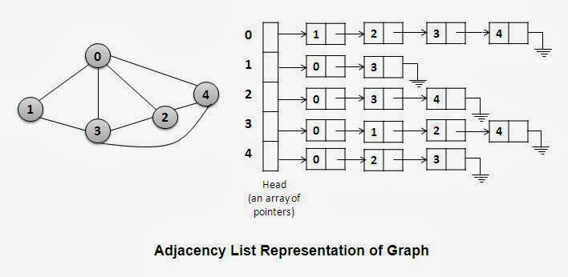

Slide 6

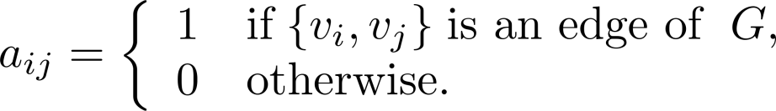
Representation of Graphs: Adjacency Matrices
Definition: Suppose that G = (V, E) is a simple graph where |V| = n. Arbitrarily list the vertices of G as
v₁, v₂, … , v_{n}. The adjacency matrix A_{G} of G, with respect to the listing of vertices, is the n × n zero-one
matrix with 1 as its (i, j)th entry when v_{i} and v_{j} are adjacent, and 0 as its (i, j)th entry when they are not adjacent.
In other words, if the graphs adjacency matrix is
A_{G} = [a_{ij}], then

Slide 7

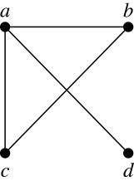
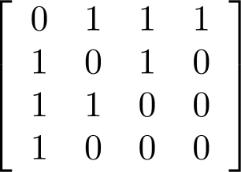
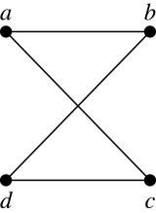
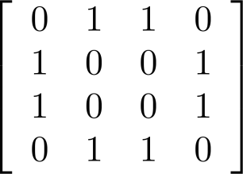
Adjacency Matrices (continued)
Example:
When a graph is sparse, that is, it has few edges relatively to the total number of possible edges, it is much more efficient to represent the graph using an adjacency list than an adjacency matrix. But for a dense graph, which includes a high percentage of possible edges, an adjacency matrix is preferable.
The ordering of vertices is a, b, c, d.
The ordering of vertices is a, b, c, d.
Note: The adjacency matrix of a simple graph is symmetric, i.e., a_{ij} = a_{ji}
Also, since there are no loops, each diagonal entry a_{ij} for i = 1, 2, 3, …, n, is 0.

Slide 8

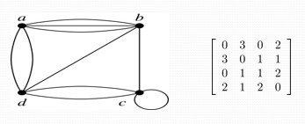
Adjacency Matrices (continued)
Adjacency matrices can also be used to represent graphs with loops and multiple edges.
A loop at the vertex vi is represented by a 1 at the (i, j)th position of the matrix.
When multiple edges connect the same pair of vertices vi and vj, (or if multiple loops are present at the same vertex), the (i, j)th entry equals the number of edges connecting the pair of vertices.
Example: We give the adjacency matrix of the pseudograph
shown here using the ordering of vertices a, b, c, d.

Slide 9

Adjacency Matrices (continued)
Adjacency matrices can also be used to represent directed graphs. The matrix for a directed graph G = (V, E) has a 1 in its (i, j)th position if there is an edge from v_{i} to v_{j}, where v₁, v₂, … v_{n} is a list of the vertices.
In other words, if the graphs adjacency matrix is A_{G} = [a_{ij}], then
The adjacency matrix for a directed graph does not have to be symmetric, because there may not be an edge from v_{i} to v_{j}, when there is an edge from v_{j} to v_{i}.
To represent directed multigraphs, the value of a_{ij} is the number of edges connecting v_{i} to v_{j}.

Slide 10

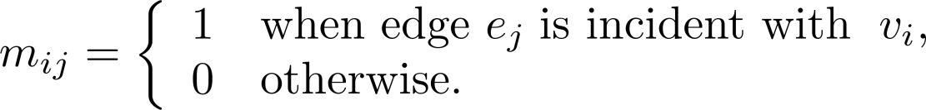
Representation of Graphs: Incidence Matrices
Definition: Let G = (V, E) be an undirected graph with vertices where v₁, v₂, … v_{n} and edges
e₁, e₂, … e_{m}. The incidence matrix with respect to the ordering of V and E is the n × m matrix M = [m_{ij}], where

Slide 11
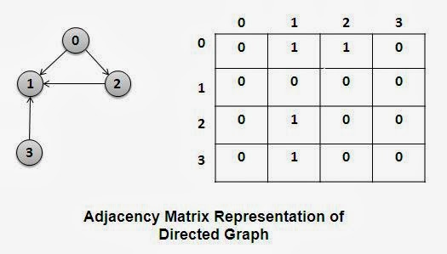

Slide 12
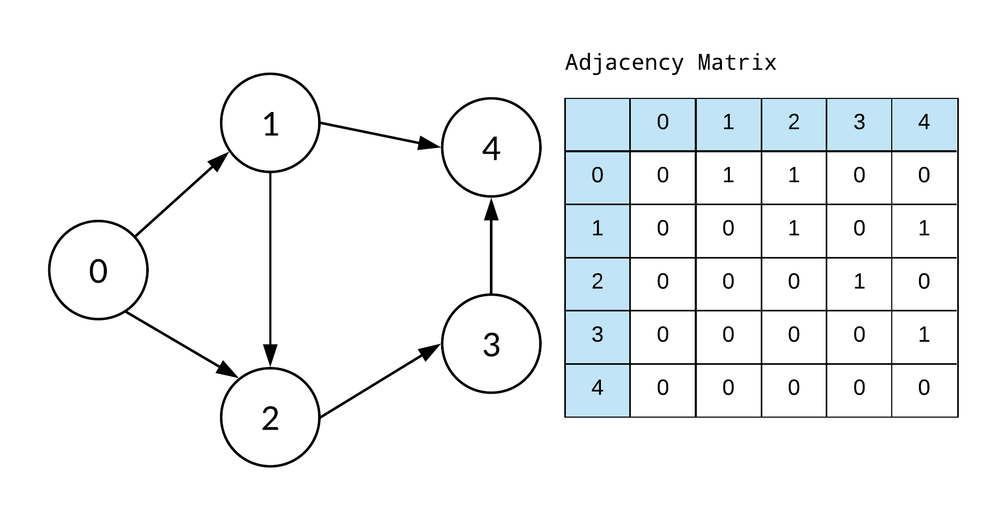

Slide 13
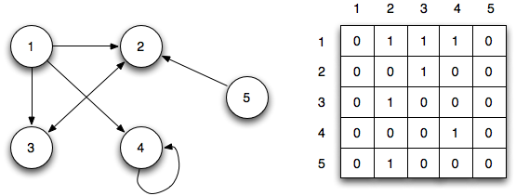

Slide 14

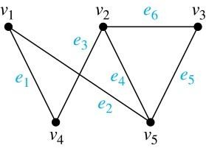
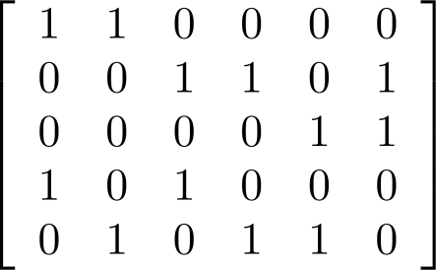
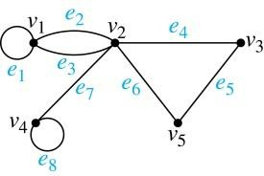
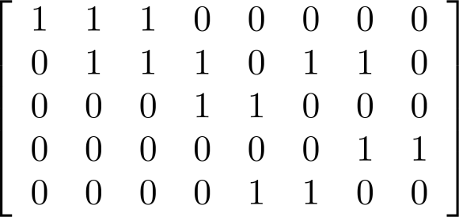
Incidence Matrices (continued)
Example: Simple Graph and Incidence Matrix
The rows going from top to bottom represent v₁ through v₅ and the columns going from left to right represent e₁ through e₆.
Example: Pseudograph and Incidence Matrix
The rows going
from top to bottom represent v₁ through v₅ and the columns going from left to right represent e₁ through e₈.

Slide 15
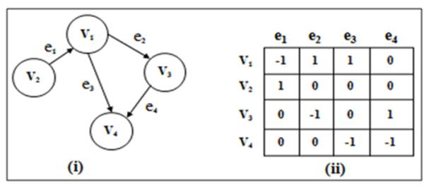

Slide 16
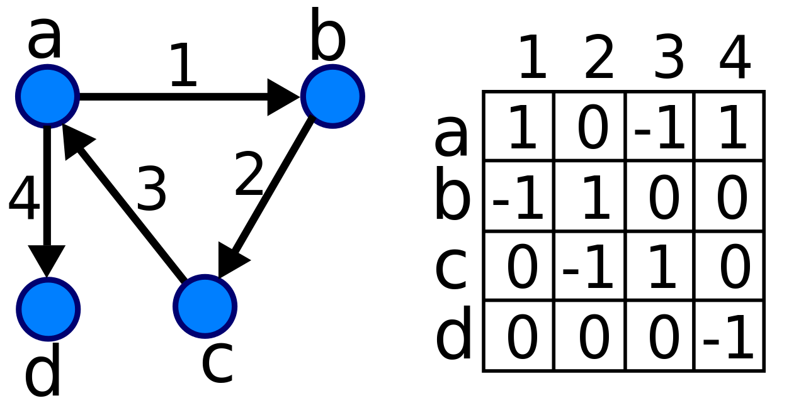

Slide 17
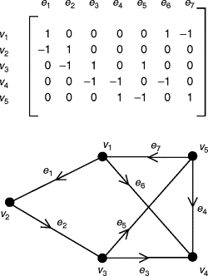

Slide 18

Section 10.4

Slide 19

Section Summary
Paths
Connectedness in Undirected Graphs
Connectedness in Directed Graphs
Counting Paths between Vertices

Slide 20

Paths
Informal Definition: A path is a sequence of edges that begins at a vertex of a graph and travels from vertex to vertex along edges of the graph. As the path travels along its edges, it visits the vertices along this path, that is, the endpoints of these.
Applications: Numerous problems can be modeled with paths formed by traveling along edges of graphs such as:
determining whether a message can be sent between
two computers.
efficiently planning routes for mail delivery.

Slide 21

Paths
Definition: Let n be a nonnegative integer and G an undirected graph. A path of length n from u to v in G is a sequence of n edges e₁, … , e_{n} of G for which there exists a sequence x₀ = u, x₁, …, x_{n-1}, x_{n} = v of vertices such that e_{i} has, for i = 1, …, n, the endpoints x_{i-1} and x_{i}.
When the graph is simple, we denote this path by its vertex sequence x₀, x₁, … , x_{n}(since listing the vertices uniquely determines the path).
The path is a circuit if it begins and ends at the same vertex (u = v) and has length greater than zero.
The path or circuit is said to pass through the vertices
x₁, x₂, … , x_{n-1} and traverse the edges e₁, … , e_{n}.
A path or circuit is simple if it does not contain the
same edge more than once.

Slide 22

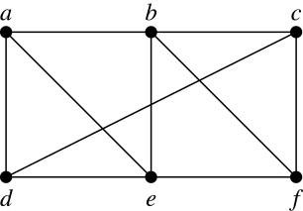
Paths (continued)
Example: In the simple graph here:
a, d, c, f, e is a simple path of length 4.
d, e, c, a is not a path because e is not connected to c.
b, c, f, e, b is a circuit of length 4.
a, b, e, d, a, b is a path of length 5, but it is not a simple path.

Slide 23

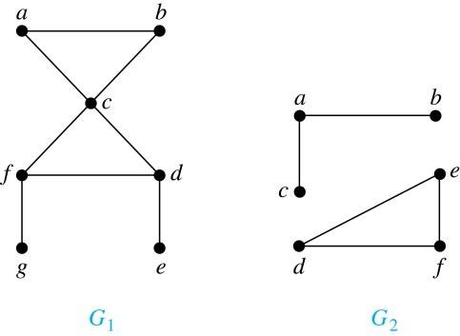
Connectedness in Undirected Graphs
Definition: An undirected graph is called connected if there is a path between every pair of vertices. An undirected graph that is not connected is called disconnected. We say that we disconnect a graph when we remove vertices or edges, or both, to produce a disconnected subgraph.
Example: G₁ is connected because there is a path between any pair of its vertices, as can be easily seen. However G₂ is not connected because there is no path between vertices a and f, for example.

Slide 24

Section 10.5

Slide 27

Section Summary
Euler Paths and Circuits
Hamilton Paths and Circuits
Applications of Hamilton Circuits

Slide 28


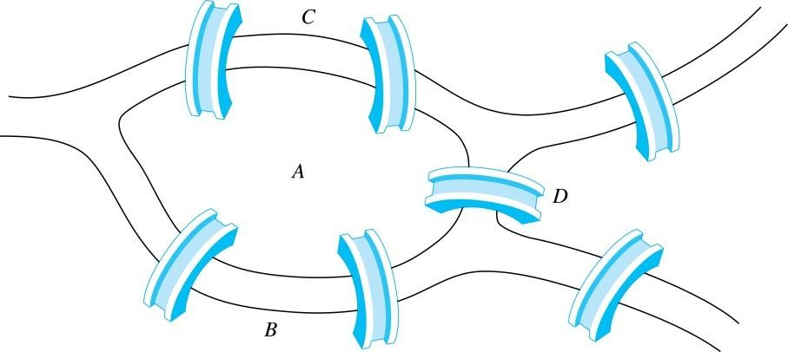
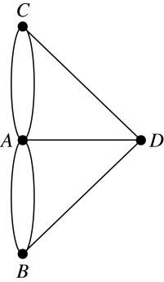
Euler Paths and Circuits
The town of Kӧnigsberg, Prussia
(now Kalingrad, Russia) was divided into
Leonard Euler
(1707-1783)
four sections by the branches of the Pregel river. In the 18th century
seven bridges connected these regions.
People wondered whether whether it was possible to follow a path that crosses each bridge exactly once and returns to the starting point.
The Swiss mathematician Leonard Euler proved that no such path exists. This result is often considered to be the first theorem ever proved in graph theory.
Multigraph Model of the Bridges of Kӧnigsberg
The 7 Bridges of Kӧnigsberg

Slide 29

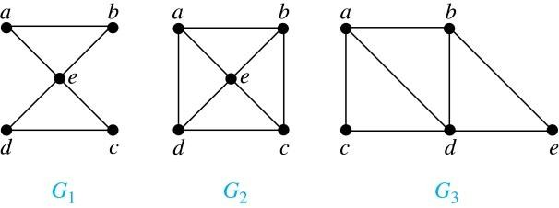
Euler Paths and Circuits
Definition: An Euler circuit in a graph G is a simple circuit containing every edge of G. An Euler path in G is a simple path containing every edge of G.
Example: Which of the undirected graphs G₁, G₂, and G₃ has a Euler circuit? Of those that do not, which has an Euler path?
Solution: The graph G₁ has an Euler circuit (e.g., a, e, c, d, e, b, a). But, as can easily be verified by inspection, neither G₂ nor G₃ has an Euler circuit. Note that G₃ has an Euler path (e.g., a, c, d, e, b, d, a, b), but there is no Euler path in G₂, which can be verified by inspection.

Slide 30

Necessary Conditions for Euler Circuits and Paths
An Euler circuit begins with a vertex a and continues with an edge incident with a, say {a, b}. The edge {a, b} contributes one to deg(a).
Each time the circuit passes through a vertex it contributes two to the vertex’s degree.
Finally, the circuit terminates where it started, contributing one to deg(a). Therefore deg(a) must be even.
We conclude that the degree of every other vertex must also be even.
By the same reasoning, we see that the initial vertex and the final vertex of an Euler path have odd degree, while every other vertex has even degree. So, a graph with an Euler path has exactly two vertices of odd degree.
In the next slide we will show that these necessary conditions are also sufficient conditions.

Slide 31

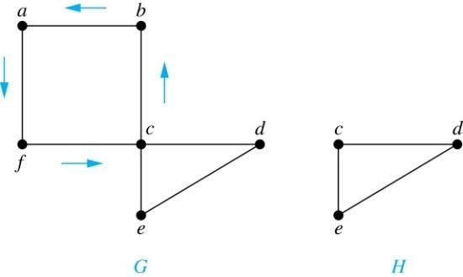
Sufficient Conditions for Euler Circuits and Paths
Suppose that G is a connected multigraph with ≥ 2 vertices, all of even degree. Let x₀ = a be a vertex of even degree. Choose an edge {x₀, x₁} incident with a and proceed to build a simple path {x₀, x₁}, {x₁, x₂}, …, {x_{n-1}, x_{n}} by adding edges one by one until another edge can not be added.
We illustrate this idea in the graph G here. We begin at a and choose the edges {a, f}, {f, c}, {c, b}, and {b, a} in succession.
The path begins at a with an edge of the form {a, x}; we show that it must terminate
at a with an edge of the form {y, a}. Since each vertex has an even degree, there must be an even number of edges incident with this vertex. Hence, every time we enter a vertex other than a, we can leave it. Therefore, the path can only end at a.
If all of the edges have been used, an Euler circuit has been constructed. Otherwise, consider the subgraph H obtained from G by deleting the edges already used.
In the example H consists of the vertices c, d, e.

Slide 32

Sufficient Conditions for Euler Circuits and Paths
Because G is connected, H must have at least one vertex in common with the circuit that has been deleted.
In the example, the vertex is c.
Every vertex in H must have even degree because all the vertices in G have even degree and for each vertex, pairs of edges incident with this vertex have been deleted. Beginning with the shared vertex construct a path ending in the same vertex (as was done before). Then splice this new circuit into the original circuit.
In the example, we end up with the circuit a, f, c, d, e, c, b, a.
Continue this process until all edges have been used. This produces an Euler circuit. Since every edge is included and no edge is included more than once.
Similar reasoning can be used to show that a graph with exactly two vertices of odd degree must have an Euler path connecting these two vertices of odd degree

Slide 33

Algorithm for Constructing an Euler Circuits
In our proof we developed this algorithms for constructing a Euler circuit in a graph with no vertices of odd degree.
procedure Euler(G: connected multigraph with all vertices of even degree)
circuit := a circuit in G beginning at an arbitrarily chosen vertex with edges
successively added to form a path that returns to this vertex.
H := G with the edges of this circuit removed
while H has edges
subciruit := a circuit in H beginning at a vertex in H that also is an endpoint of an edge in circuit.
H := H with edges of subciruit and all isolated vertices removed
circuit := circuit with subcircuit inserted at the appropriate vertex.
return circuit{circuit is an Euler circuit}

Slide 34

Necessary and Sufficient Conditions for Euler Circuits and Paths (continued)
Theorem: A connected multigraph with at least two vertices has an Euler circuit if and only if each of its vertices has an even degree and it has an Euler path if and only if it has exactly two vertices of odd degree.
Example: Two of the vertices in the multigraph model of the Kӧnigsberg bridge problem have odd degree. Hence, there is no Euler circuit in this multigraph and it is impossible to start at a given point, cross each bridge exactly once, and return to the starting point.

Slide 35

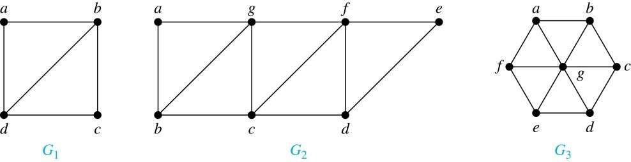
Euler Circuits and Paths
Example:
G₁ contains exactly two vertices of odd degree (b and d). Hence it has
an Euler path, e.g., d, a, b, c, d, b.
G₂ has exactly two vertices of odd degree (b and d). Hence it has an Euler path, e.g., b, a, g, f, e, d, c, g, b, c, f, d.
G₃ has six vertices of odd degree. Hence, it does not have an Euler path.

Slide 36

Applications of Euler Paths and Circuits
Euler paths and circuits can be used to solve many practical problems such as finding a path or circuit that traverses each
street in a neighborhood,
road in a transportation network,
connection in a utility grid,
link in a communications network.
Other applications are found in the
layout of circuits,
network multicasting,
molecular biology, where Euler paths are used in the sequencing of DNA.

